Slide 1

Facilitating water conservation in domestic households
Submitted by:- Shashank Mishra
Sachin Yadav
Abhay Gupta
Neelesh
Submitted to: Manish Kaushik
Design Thinking I
ACSE0203

Slide 2
+
EMPATHY

Slide 3


I feel guilty seeing so much water go to waste.
It's challenging to estimate the right amount of water to prepare for each day.
I wish there were better ways to manage leftovers and surplus water.
I need practical solutions to reduce water waste without compromising the quality of the water.
It would be great to collaborate with local NGOs ofor donation purposes.
Educating my staff and customers about the importance of minimizing water waste is crucial.
`
EMPATHY MAP
SAYS
THINKS
DOES
FEELS
Conducts research to find innovative techniques and technologies
Implements portion control measures in the restaurant to avoid excessive water preparation.
Actively seeks partnerships with local NGOs, water banks, or shelters to donate surplus water.
Concerned about the impact of water waste on the environment and society.
Frustrated by the lack of efficient systems for managing water inventory and minimizing waste.
Motivated to take action and make a positive difference.

Slide 4

Persona of a child
Drip detective: I'll teach you how to become a "Drip Detective" by checking for leaks in faucets and pipes. We can go on a water leak hunt together and fix any drips we find. It's like being a water-saving superhero!.,
Creative Reuse: I'll help you explore creative ways to reuse water. We can collect leftover drinking water in a jug and use it to water plants. Or we can use leftover bathwater to give thirsty plants a drink. It's like giving water a new purpose!.
NAME
AGE
GENDER
EDUCATION
NATIONALITY
Lily
10
FEMALE
5TH GRADE
INDIAN
Bucket Bridge: Lily When waiting for the tap water to get hot or cold, we can place a bucket under the faucet to catch the water. We can use this "waiting water" for plants or cleaning. It's like giving the water a second chance!.

Slide 5

Persona of a working adult
Water Audit: I can conduct a thorough assessment of your household's water consumption patterns, taking into account factors such as appliances, fixtures, irrigation systems, and landscaping. Based on the audit, I'll provide personalized recommendations tailored to your lifestyle and budge.
Education and awareness: I can organize workshops or share educational resources to increase awareness about water conservation among your colleagues, friends, and family. By fostering a culture of sustainability, we can multiply our impact and inspire others to join the movement..
NAME
AGE
GENDER
JOB
NATIONALITY
SHYAM
37
MALE
MARKETING MANAGER
INDIAN
Smart Technologies: Ram’ I can introduce you to smart home technologies designed to optimize water usage. From smart irrigation controllers that adjust watering schedules based on weather conditions to leak detection systems that provide real-time alerts, these technologies offer convenience and efficiency, even when you're away from home..

Slide 6
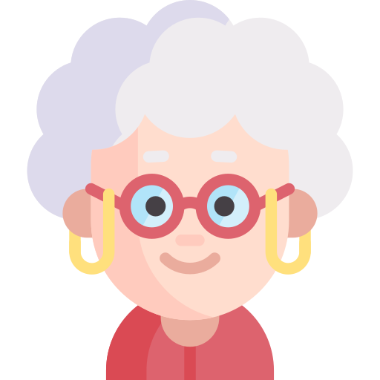
Persona of An old person
Rain Blessing: As Rainwater is a gift from the heavens. Let's collect it! I'll show you how to set up rain barrels or cisterns to capture rainwater, which can be used for watering plants or cleaning. We'll honor the blessings of rain and make the most of every drop.
Legacy of Repair: I believe in the power of repair and maintenance. Let's fix those leaky faucets, pipes, and toilets together. Small leaks can waste a surprising amount of water over time, so we'll take care of them promptly. Your dedication to repairing will inspire others to follow suit.
NAME
AGE
GENDER
NATIONALITY
PARVATI
75
FEMALE
INDIAN
Community Sharing: In our community, we can organize workshops or gatherings where we share our knowledge of water conservation. By fostering a sense of collective responsibility, we can make a lasting impact and inspire others to join our cause..

Slide 7
C
O
T
W
E
A

Slide 8
CUSTMER
The customers in this context are the residents of domestic households. They are the ones who consume water on a daily basis and have the ability to make choices that impact water conservation. Their awareness, attitudes, and behaviors regarding water usage play a crucial role in achieving effective conservation.

Slide 9
ACTOR
The actors involved in water conservation in domestic households include individuals, families, water utility companies, government agencies, and organizations promoting sustainable living. These actors may provide guidance, incentives, regulations, or technological solutions to encourage water conservation practices.

Slide 10
CUSTMER
ACTOR
TRANSFORMATION
The transformation refers to the desired change or outcome in water conservation. It involves reducing water consumption, minimizing wastage, and adopting sustainable practices within domestic households. The goal is to achieve a significant reduction in water usage while maintaining the desired quality of life.

Slide 11
CUSTMER
ACTOR
WORLD VIEW
The worldview in water conservation encompasses the belief that water is a valuable and limited resource that must be preserved for present and future generations. It recognizes the interconnectedness of human activities and the environment, promoting sustainable practices and responsible stewardship of natural resources.

Slide 12
CUSTMER
ACTOR
OWNER
The owner represents the entity responsible for ensuring water conservation in domestic households. It could be the government, water utility companies, environmental organizations, or individual households themselves. The owner has the authority to implement policies, regulations, and initiatives to drive water conservation efforts.

Slide 13
CUSTMER
ACTOR
ENVIRONMENTALCONSTRAINTS
The environment includes the natural ecosystems, water sources, and the overall ecological balance. Water conservation in domestic households aims to protect the environment by reducing the extraction of freshwater resources, minimizing pollution, and preserving aquatic ecosystems.

Slide 14
+
DEFINE

Slide 15
Who?
Environment
Water-Insecure Populations
Society at Large
What?
Identifying what constitutes water waste is crucial. Water waste includes any edible water that is discarded or left & not drinken. This can include spoiled or trimmings, peels, leftovers, and excess or surplus water
4
W’s
Where?
Identifying where water waste occurs helps in developing targeted strategies to control it. Water waste can occur in households, restaurants, grocery stores, farms, and industrial water production facilities.
Why?
Understanding the reasons behind the need to control water waste is essential. Water waste has significant environmental, social, and economic impacts. It contributes to greenhouse gas emissions, wasteful use of resources, and water insecurity.

Slide 16
PROBLEM: Promoting Water-Efficient Appliances in Domestic Households
WHY
Why is there excessive domestics water waste?
WHY
Why is the water bill too high?
WHY
Why has the water usage increased significantly?
WHY
why is there a constant leak in the plumbing system?
WHY
Why haven’t the pipes been replaced or repaired?
ROOT CAUSE : We need to replaced the corrades pipes that have not replaced by the house owner due to lack o awareness.

Slide 17
+
IDEATE

Slide 18
Water Planning
Community Garden
Random Association Technique
Water Preservation
Rainwater manageme-nt
Re-use of water
Water Waste Audits

Slide 19
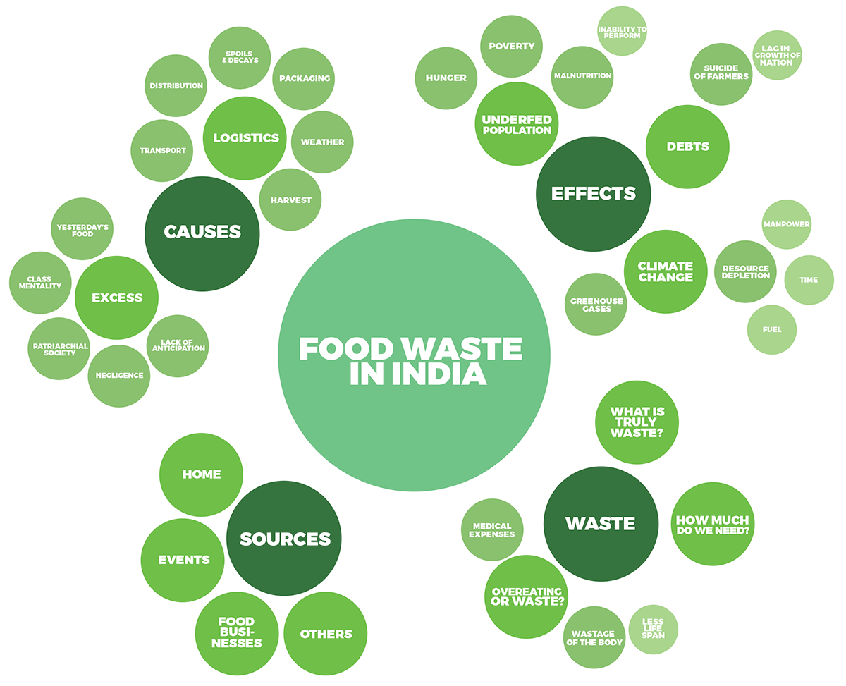

MIND MAP
WATER WASTE IN INDIA

Slide 20

Awareness Campaigns
Composting Programs
Water Waste Tracking Apps
Water Recovery Programs
BRAIN STRORM
School Education Programs
Creative Recipes
Collaboration with Water Retailers
Portion Control

Slide 21
+
Prototype &
test

Slide 22
water WASTE CONTROL SYSTEM
Smart Inventory Management
Intelligent Demand Prediction
Consumer Engagement Mobile App
water Donation Network
Waste Analytics and Reporting
Collaborative Partnerships

Slide 23


